Slide 1

Waiyat Hamdani Tool used: Java , Javelin ,Docker ,Dbeaver
Project 0-
Postman Bank W Demonstration

Slide 2
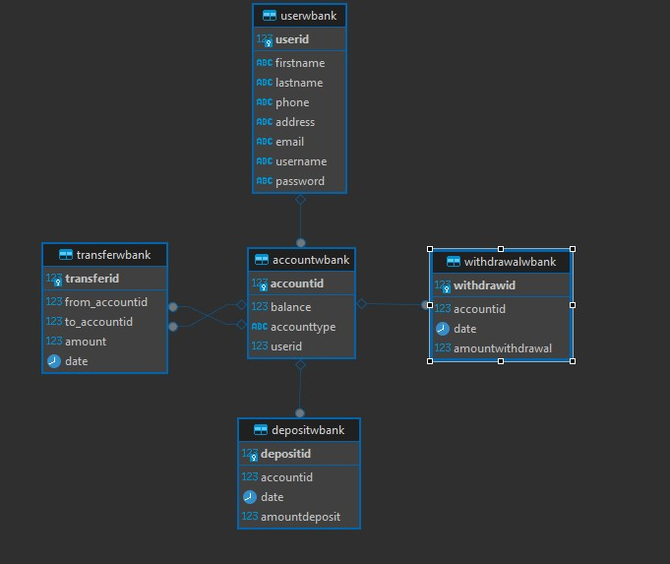
ERD- Diagram

Slide 3
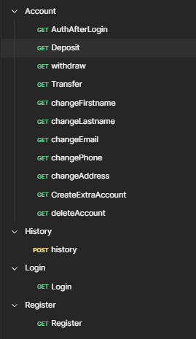
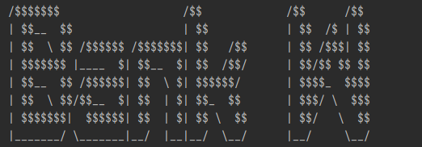
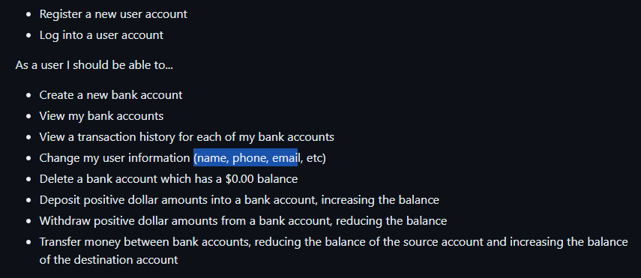
What To know about Bank W

Slide 4
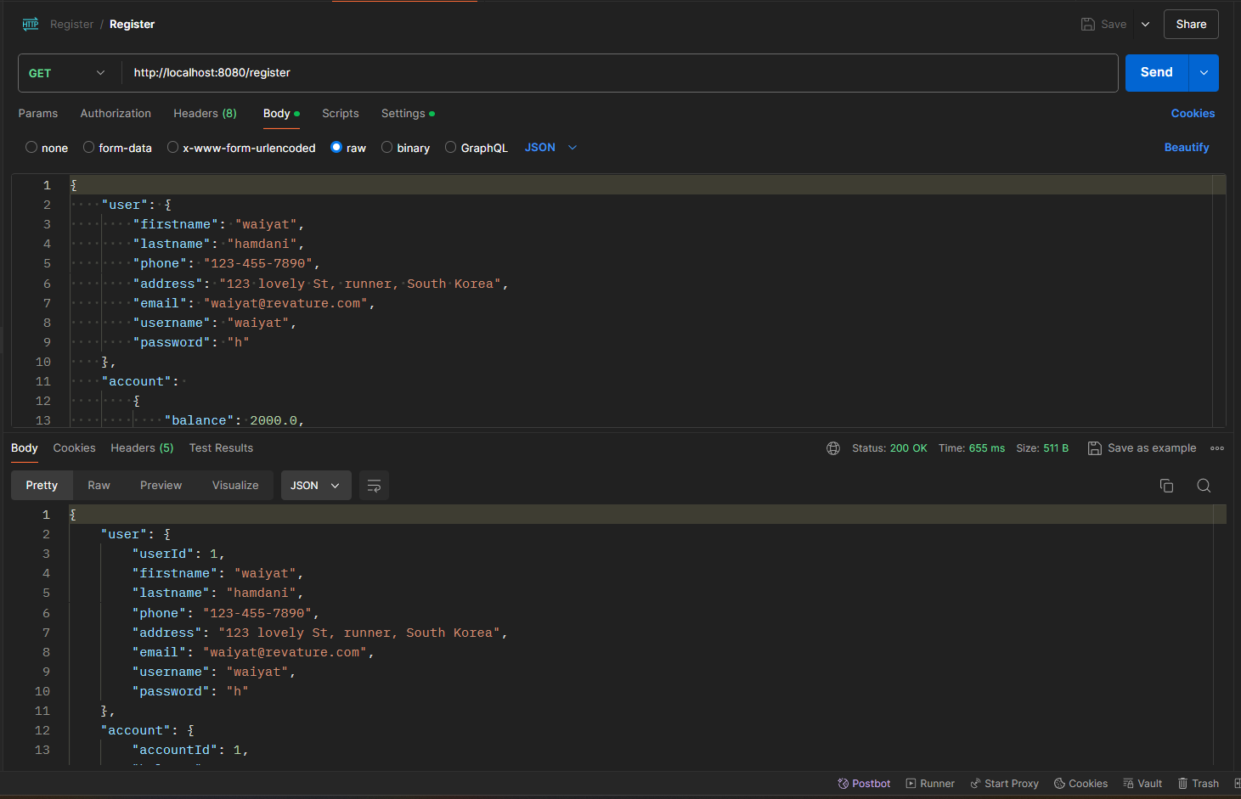
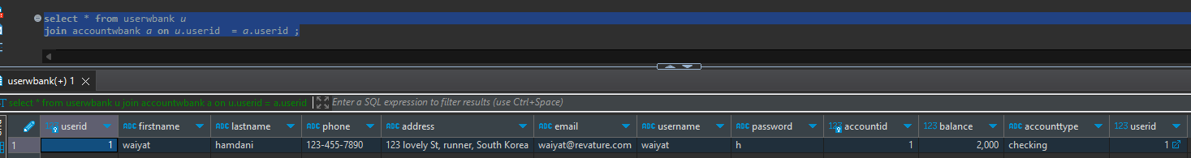
Expected : Register - User automatically register one account
In the real life
bank every time user register always including one account .
That what we expected to achive
Note : Remember it does register the user and account but before you login Run root one more time

Slide 5
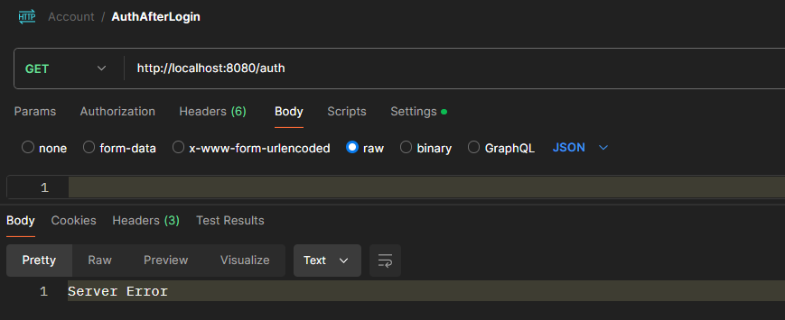
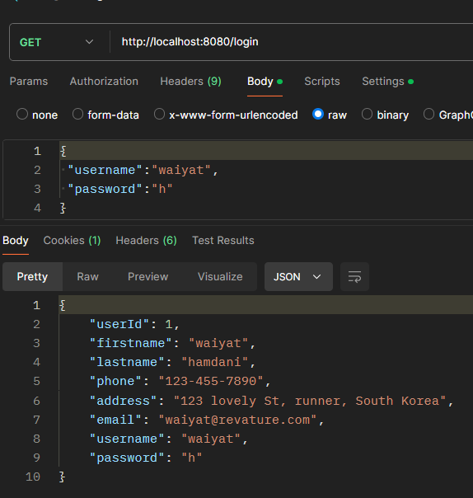
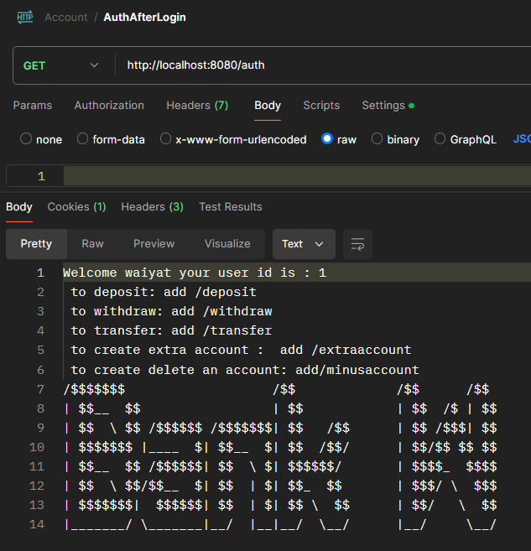
Expected: Login and Auth !!
If you not login and goes to auth you will expected error (Cause again you not authorize)
If you login and successful you should see this

Slide 6
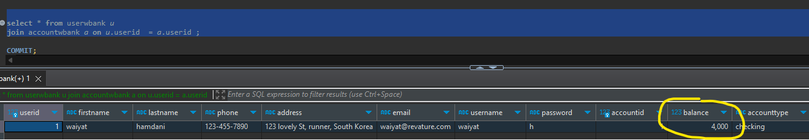
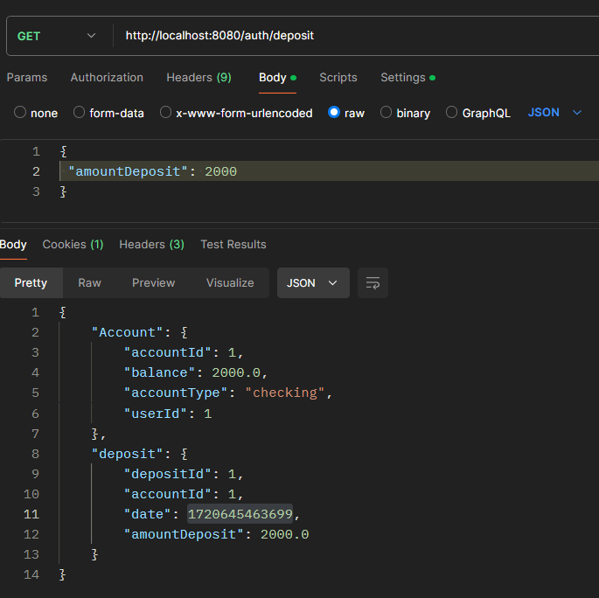
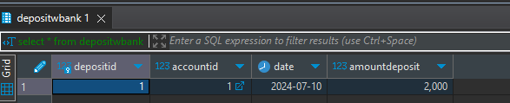
Expected : Deposit
It will show currently how much in your account right now .
Also will show how much you deposited today

Slide 7
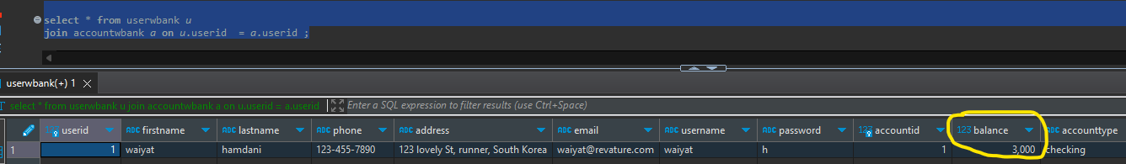
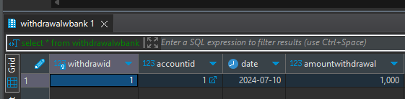
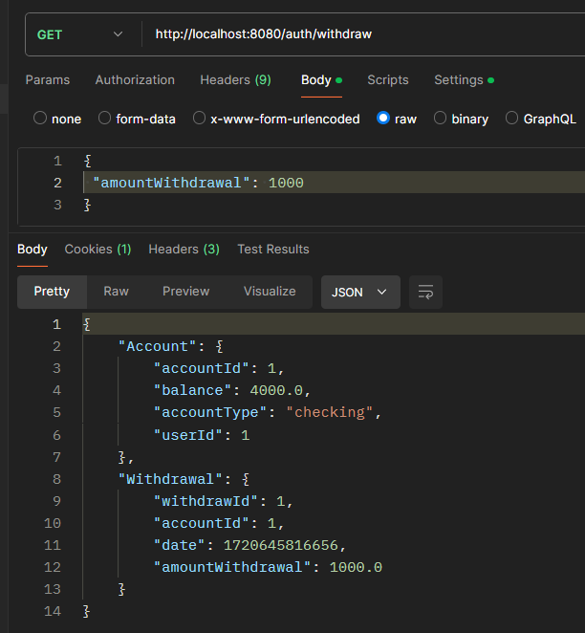
Expected : Withdraw
It will show how much currently you have in your account
And how much expected withdrawal

Slide 8
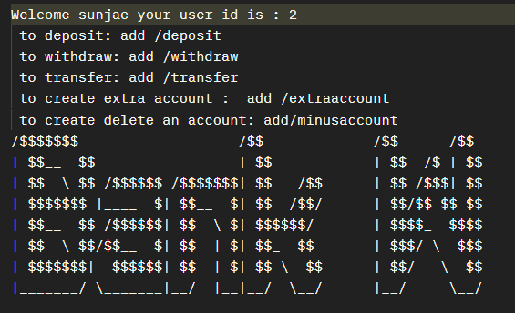

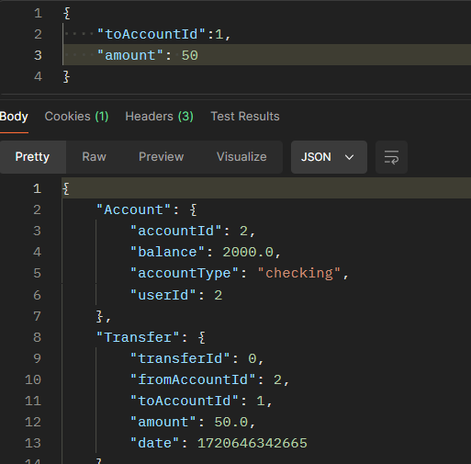
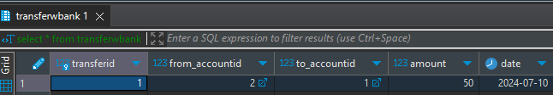
Expected: Transfer
In this purpose , We creating another account for sunjae to sent money for me
Thank you Sunjae to make me $50 richer

Slide 9

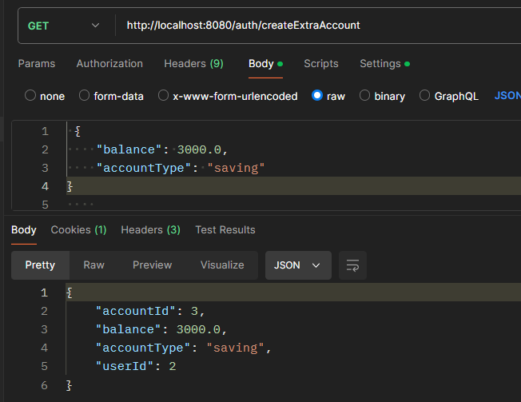
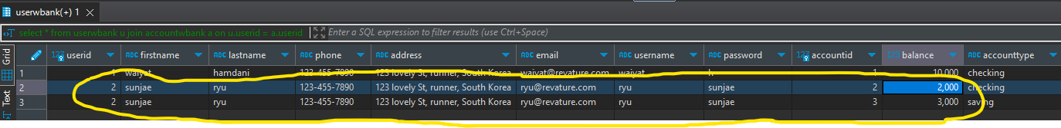
Expected - Create Extra Account
Ryu Sunjae Want to create saving account to buy ImSol birthday gift
In this case we going to login to Ryu-Sunjae and we going to create an extra account for him
Now We have an extra account for him

Slide 10

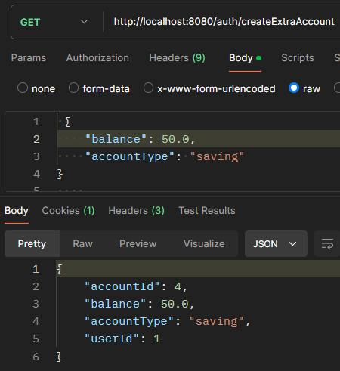
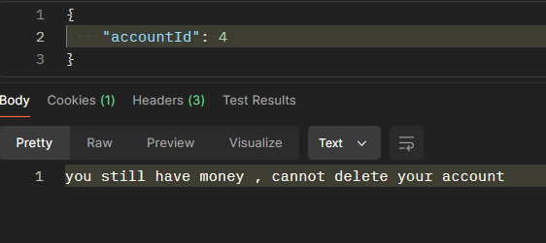
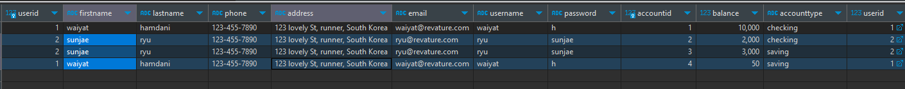
Expected : Delete Account
We going to Use me this time !! we going to create a saving account and put $50 in it and transfer it into Imsol account id 3 that Ryu Sunjae created
created
If I deleted without emptying the account

Slide 11
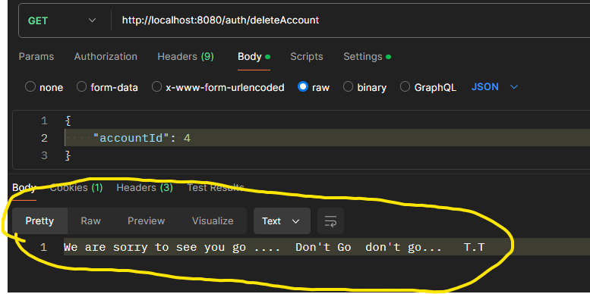
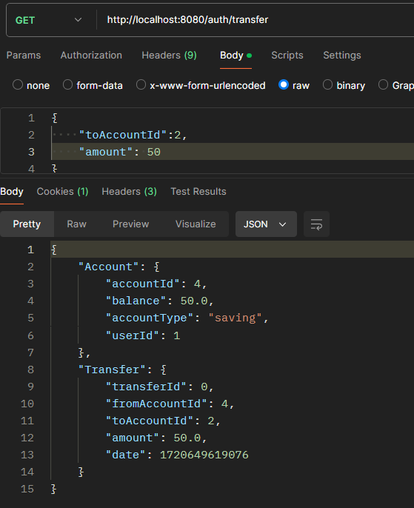
Continuation of Deleted Account Expectation
Waiyat Should Able to delete it !!
Now that account is empty

Slide 12
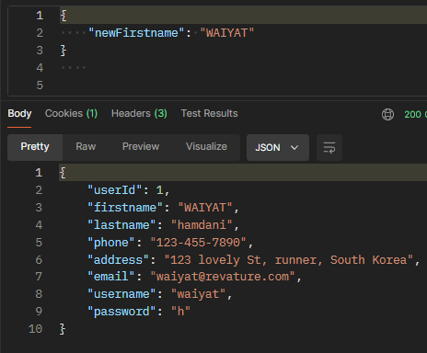
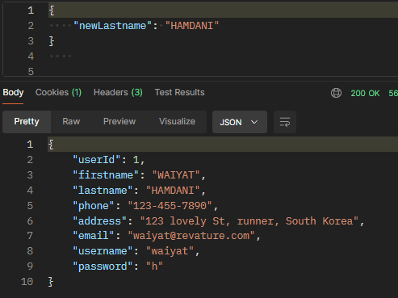
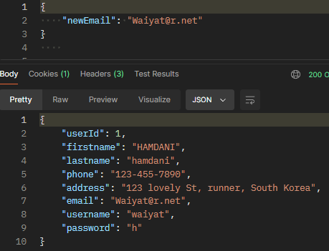
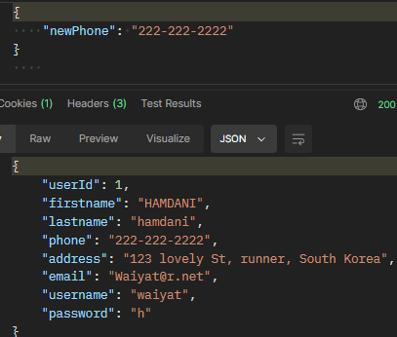
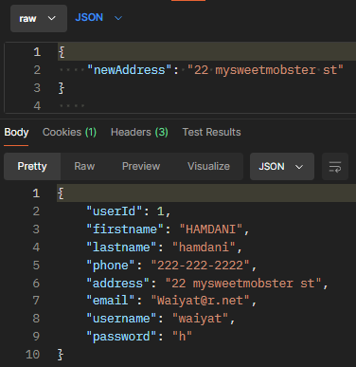
Expected : All change Info
(Firstname, Lastname, Email , Phone,Address , Email)
original
What changes

Slide 13
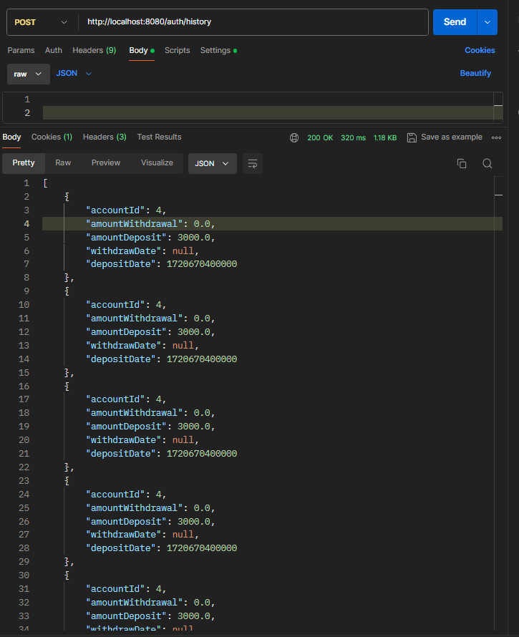
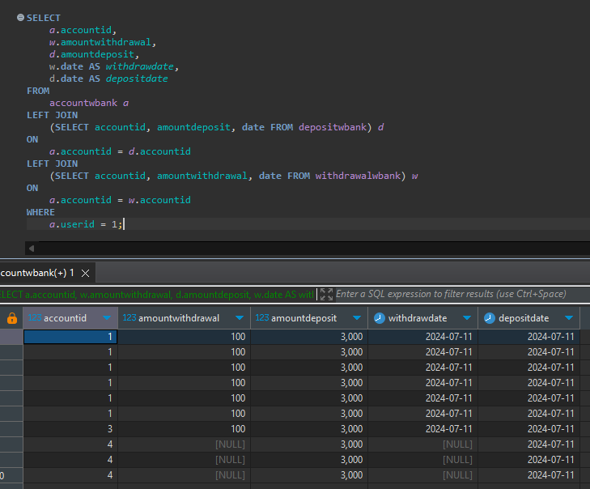
Expected : History
May be
Buggy !!
It should expected as the same as this query !!

